Slide 1
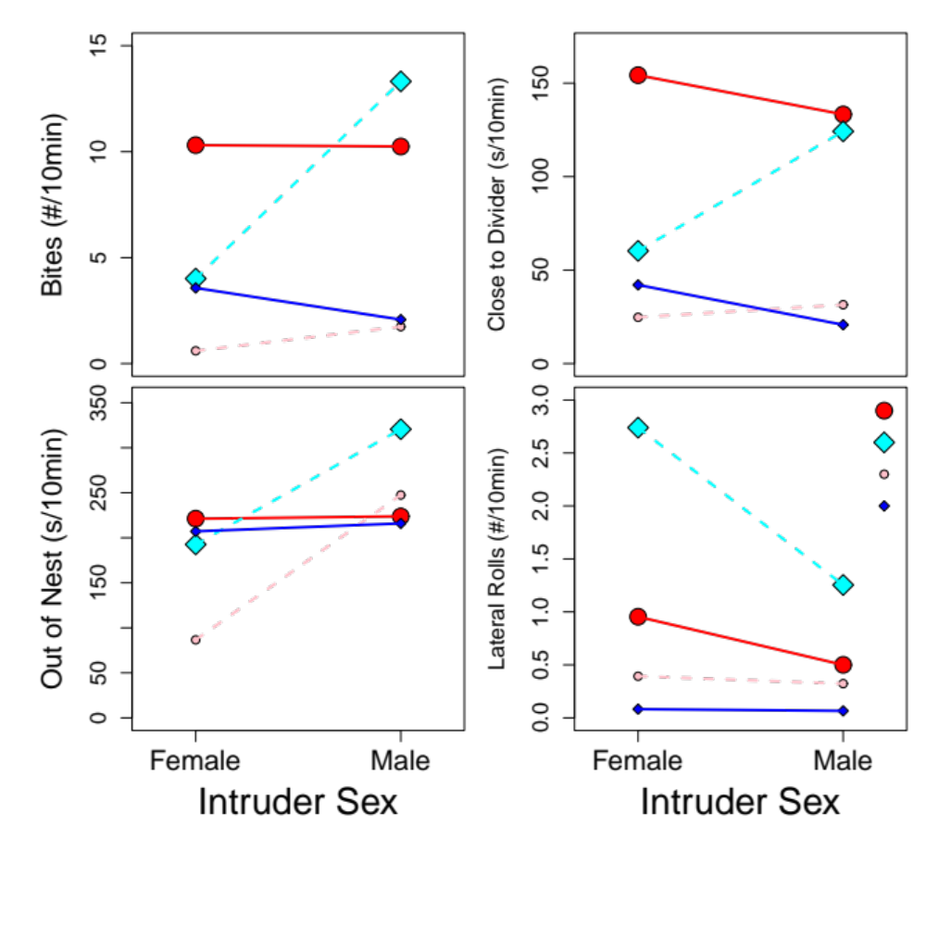
A
B
p = 0.008
p = 0.095
p = 0.065
p = 0.016
p = 0.098
p = 0.022
C
D
Large Female
Large Male
Small Female
Small Male
p = 0.016
p < 0.001
p = 0.067
p = 0.019
p = 0.003
p = 0.083

